Slide 1
Deep Learning Community of Practice Deep Learning Logistics
Daniel Kick, Coordinator

Slide 2
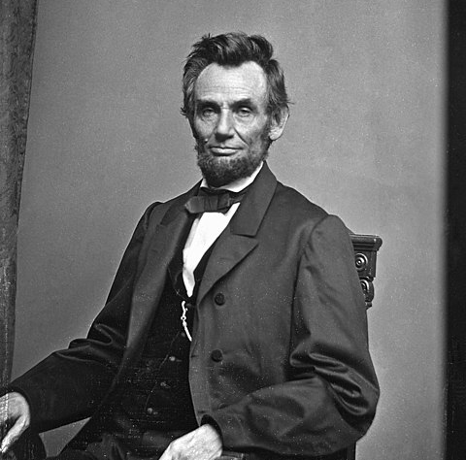
Starting with the Data
build a model
^
cleaning my data
^
“If I had eight hours to chop down a tree, I’d spend the first six of them sharpening my axe.”
Abraham Lincoln if he worked with data

Slide 3
Data Cleaning
Some data ➜ … ➜ n-dimensional arrays (tensors)
Amount of preprocessing will depend on domain
Extract – Retrieve from disparate sources / files
Transform – Standardization of format, quality control, imputation, etc.
Load – Inserting “clean” data into target storage

Slide 4
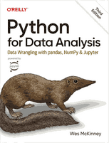
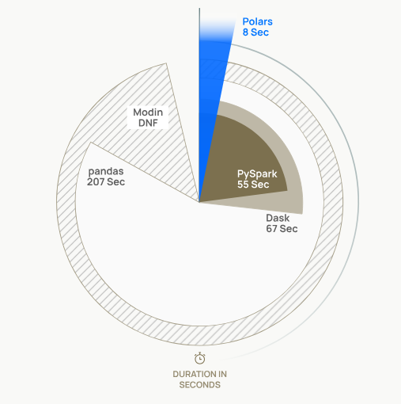
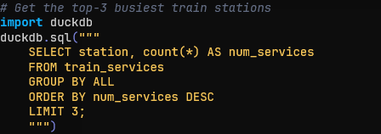
Data Cleaning in Python
Pandas
Standard Choice
Build on numpy arrays
Indexes by default
Polars
Fast but less widely used
Build on apache arrow format
RDBMS (e.g. DuckDB, sqlite3)
SQL
Portable

Slide 5
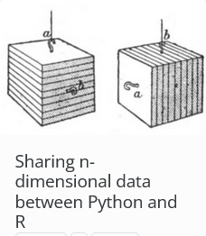
Separate data prep from modeling
Use the right tool, not the tool that’s closest at hand
R has wonderful tooling for data manipulation
Beware of differing assumptions between languages
0-1 indexing
R and Python index n-dimensional arrays differently
Think about formats that provide flexibility
https://jacobwashburn-usda.github.io/LabProtocols/posts/DanielKick/241024_n_dim_arrays_R_v_np/

Slide 6

Not fooling oneself
“The first principle is that you must not fool yourself—and you are the easiest person to fool”
Richard Feynman

Slide 7
Defining a Holdout Set
Observations

Slide 8
Defining a Holdout Set
Site A
2014
Site B
Site C
Site A
2015
Site B
Site C
Observations

Slide 9
Defining a Holdout Set
Site A
2014
Site B
Site C
Site A
2015
Site B
Site C
Observations

Slide 10
Defining a Holdout Set
Site A
2014
Site B
Site C
Site A
2015
Site B
Testing Set
Site C
Observations

Slide 11
Defining a Holdout Set
Site A
2014
Site B
Site C
Site A
2015
Site B
Environments contribute to error equally
Testing Set
Site C
Observations

Slide 12
Key Questions:
Is there structure to your data you should account for in your sets?
Locations
Relatedness of individuals
Time
Is it possible for information from your testing set to “leak” into your training set?
E.g. Are values imputed or scaled based on all data?
How many splits do you need?
Test / train? Test / validate / train? Test/ validate 1 … validate # / train?

Slide 13
Case Study: Preparing to Predict Viral Infection Potential

Slide 14
Case Study: Preparing Sequence Data for Modeling
Goal: Given a virus’ nucleotide sequence predict which species it will infect
Data:
Species0 {v0: ACGTR, v1: YSWKM, …}
Species1 {v0: ACGTR, v1: YSWKM, …}
…
Models:
Species0 (+/-)
Species1 (+/-)
…

Slide 15
Tuning and Validation:
1. How do we deal with imbalanced data?
2. Dealing unobserved targets
If there is cross infection, we might not have examples of it
If a model sees a sequence it will try to “memorize” the target
Therefore, we should examine only the predictions made on the test data to identify candidates -- the training data will underreport these
5 folds, stratified by species
sp.1
sp.2
sp.3
sp.4
sp.5

Slide 16






Separating Data Prep. from Model Tuning
Text files
(fasta)
Preparation
Extract sequences, convert IUPAC codes to probabilities, convert to k-mer probabilities
Write to portable tabular format (parquet)
Use metadata (species, sequence name) to create stratified cross validation folds
During model fitting
Query cross validation fold table
Query k-mer probability table
Write output files
Data
Preparation
Model
Exploration
Transformed
Data
Model
Tuning
Model
Fitting
Model
Production
Text files

Slide 17
Tuning and tracking

Slide 18
Hyperparameter Tuning
Define space to explore
Propose one or more options
Test one or more options
Propose one or more new options given results
Algorithms trade off
Parallelism vs Effectiveness

Slide 19
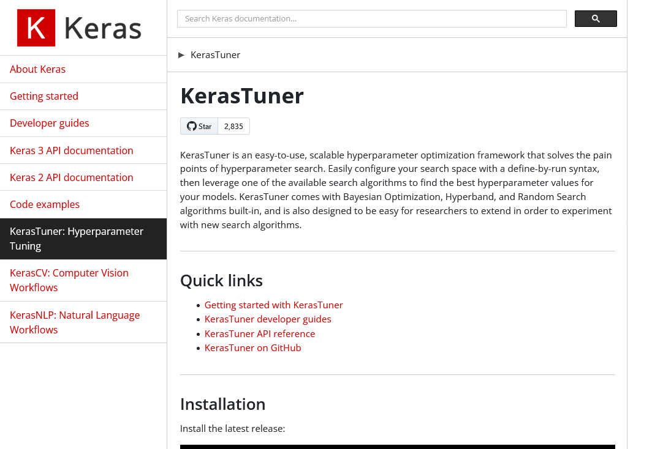
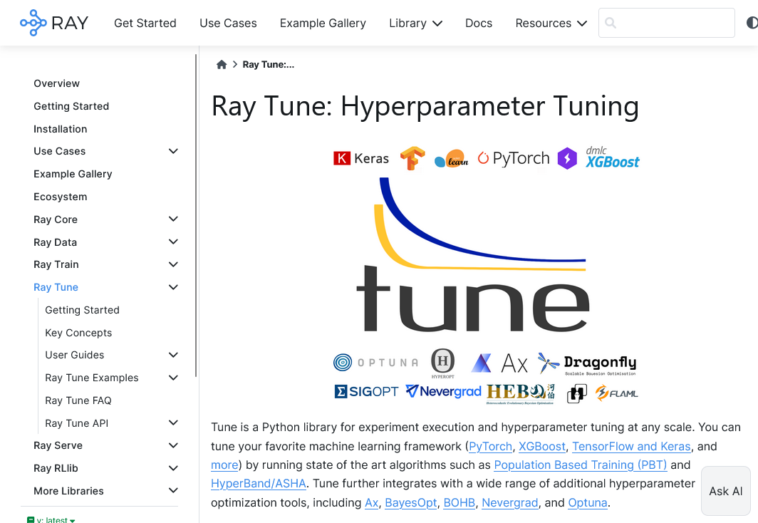
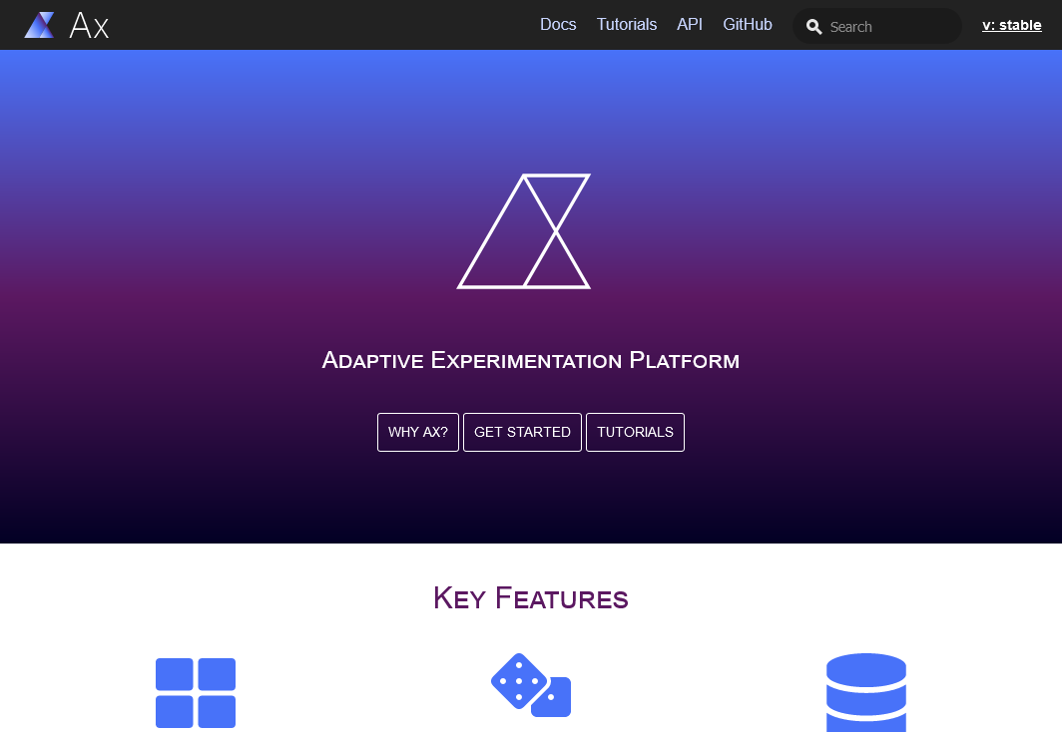
Common Hyperparameter Tuning Libraries

Slide 20
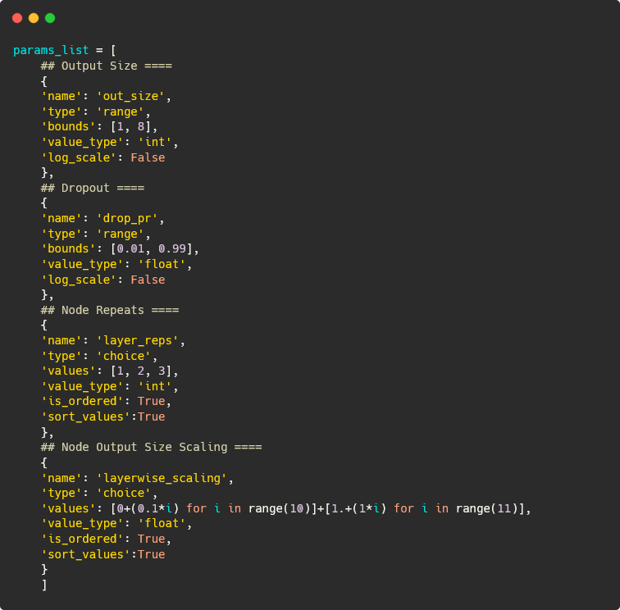
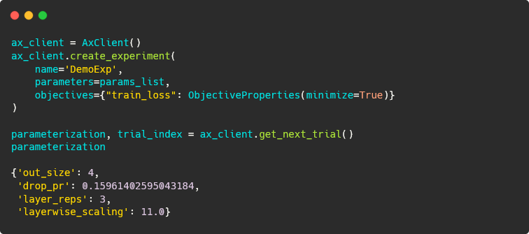
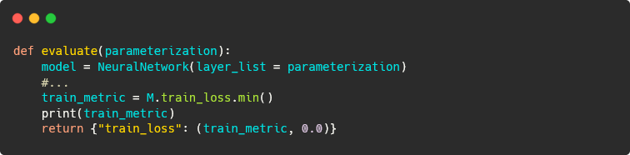
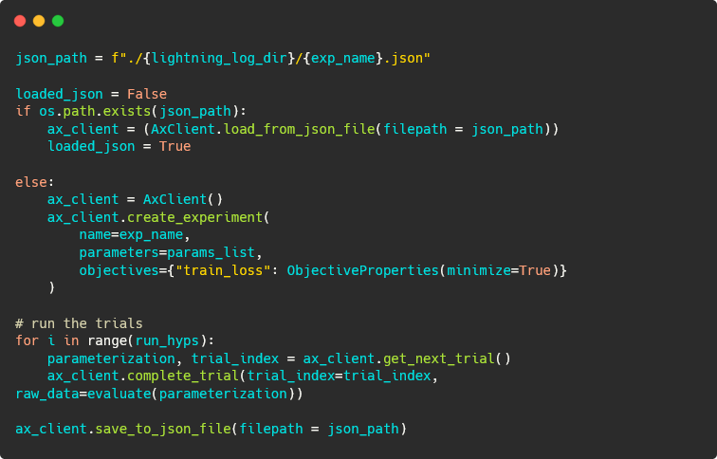
In Action: Ax
Define space to explore
Propose one or more options
Test one or more options
Propose one or more new options given results

Slide 21
In Action: Ax
Define space to explore
Propose one or more options
Test one or more options
Propose one or more new options given results

Slide 22
In Action: Ax
Define space to explore
Propose one or more options
Test one or more options
Propose one or more new options given results

Slide 23
In Action: Ax
Define space to explore
Propose one or more options
Test one or more options
Propose one or more new options given results

Slide 24
In Action: Ax
Define space to explore
Propose one or more options
Test one or more options
Propose one or more new options given results

